Slide 1

Design, prototyping and construction

Slide 2

Overview
    Prototyping and construction
    Conceptual design
    Physical design
    Tool support

Slide 3
Prototyping and construction
What is a prototype?
Why prototype?
Different kinds of prototyping
low fidelity
high fidelity
Compromises in prototyping
vertical
horizontal
Construction

Slide 4
What is a prototype?
In other design fields a prototype is a small-scale model:
a miniature car
a miniature building or town

Slide 5
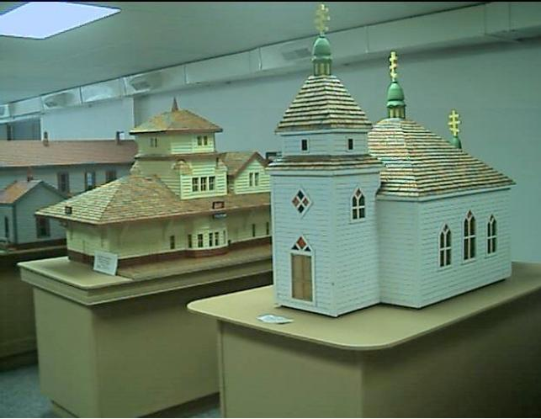

Slide 6
What is a prototype?
In interaction design it can be (among other things):
  a series of screen sketches
  a storyboard, i.e. a cartoon-like series of scenes
  a Powerpoint slide show
  a video simulating the use of a system
  a lump of wood (e.g. PalmPilot)
  a cardboard mock-up
  a piece of software with limited functionality written in the target language or in another language

Slide 7
Why prototype?
Evaluation and feedback are central to interaction design
Stakeholders can see, hold, interact with a prototype more easily than a document or a drawing
Team members can communicate effectively
You can test out ideas for yourself
It encourages reflection: very important aspect of design
Prototypes answer questions, and support designers in choosing between alternatives
Notes:
To turn an abstract idea into a physical form
this allows the designer to see if their idea can actually translate to screen designs and dialogue design in a workable way
To communicate your ideas
This allows for descriptions of how requirements are satisfied, and why the interaction style may be suitable for the intended user group
To iterate and improve
Prototypes help to nurture. Develop and document the development of the prototype.
It is important when prototyping that the users who test the system get the experience they would get if this were a real design. The user can therefore interrogate the system and could respond to tell you whether the forms in the system are too complicated or if they are just right.

Slide 8
What to prototype?
  Technical issues
  Work flow, task design
  Screen layouts and information display
  Difficult, controversial, critical areas
Notes:
Types of prototype

Slide 9
Low-fidelity Prototyping
Uses a medium which is unlike the final medium, e.g. paper, cardboard
Is quick, cheap and easily changed
Examples:
sketches of screens, task sequences, etc
‘Post-it’ notes
storyboards
‘Wizard-of-Oz’
Notes:
Rapid prototyping
Very quick prototype that is designed to look and feel like the sytem like MS word or MS PowerPoint

Slide 10
Storyboards
Often used with scenarios, bringing more detail, and a chance to role play
It is a series of sketches showing how a user might progress through a task using the device
Used early in design

Slide 11
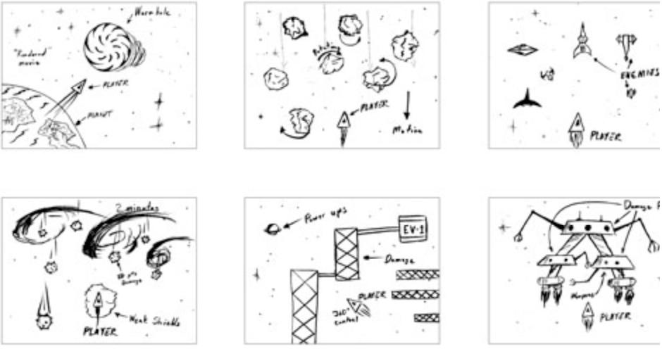

Slide 12
Sketching
Sketching is important to low-fidelity prototyping
Don’t be inhibited about drawing ability. Practice simple symbols

Slide 13
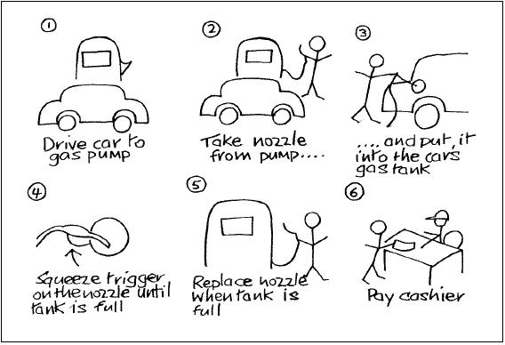

Slide 14
Using index cards
  Index cards (3 X 5 inches)
  Each card represents one screen
  Often used in website development

Slide 15
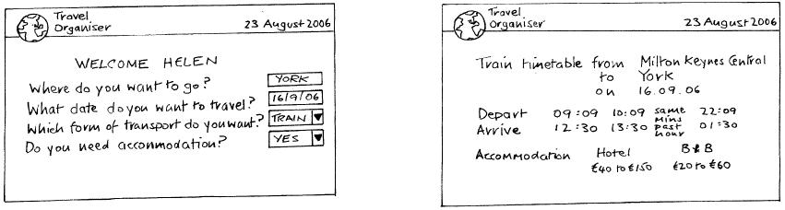

Slide 16
‘Wizard-of-Oz’ prototyping
The user thinks they are interacting with a computer, but a developer is responding to output rather than the system.
Usually done early in design to understand users’ expectations
What is ‘wrong’ with this approach?
User
>Blurb blurb
>Do this
>Why?

Slide 17
High-fidelity prototyping
  Uses materials that you would expect to be in the final product.
  Prototype looks more like the final system than a low-fidelity version.
  For a high-fidelity software prototype common environments include Macromedia Director, Visual Basic, and Smalltalk.
  Danger that users think they have a full system…….see compromises

Slide 18
Compromises in prototyping
All prototypes involve compromises
For software-based prototyping maybe there is a slow response? sketchy icons? limited functionality?
Two common types of compromise
    ‘horizontal’: provide a wide range of functions, but with little detail
    ‘vertical’: provide a lot of detail for only a few functions
Compromises in prototypes mustn’t be ignored. Product needs engineering
Notes:
Horizontal and vertical prototypes
The horizontal provides a wide range of functions, but in a relatively superficial way with the user. This may be suitable for testing the user’s ability to recognise a large range of features from their labels.
The vertical prototyping provides a small range of features only a small subset of the system’s functionality that is active, but functionality is of greater dept and provides more detail. This is good for a system that provides a large number of similar actions.

Slide 19
Construction
  Taking the prototypes (or learning from them) and creating a whole
  Quality must be attended to: usability (of course), reliability, robustness, maintainability, integrity, portability, efficiency, etc
  Product must be engineered
      Evolutionary prototyping
      ‘Throw-away’ prototyping
Notes:
Throwaway
Typically, the prototype will consist of a front end that is npartially functional, but may consist of a front end that is partially functional, but may simply mimic the behaviour of a sysstem
Evolutionary
This prototype helps to refine understanding and validate aspects of design, but the software program is retained and developed the prototype has functionality added incrementally as more design aspects are added, tested and refined
Incremental:
In this example the system is built as seperate components. The final product is then released as a series of components, each release adding a component until the complete product is dilivered.

Slide 20
Conceptual design: from requirements to design
Transform user requirements/needs into a conceptual model
“a description of the proposed system in terms of a set of integrated ideas and concepts about what it should do, behave and look like, that will be understandable by the users in the manner intended”
Don’t move to a solution too quickly. Iterate, iterate, iterate
Consider alternatives: prototyping helps

Slide 21
Three perspectives for a conceptual model
Which interaction mode?
    How the user invokes actions
    Activity-based: instructing, conversing, manipulating and navigating, exploring and browsing.
    Object-based: structured around real-world objects

Slide 22
Three perspectives for a conceptual model
Which interaction paradigm?
    desktop paradigm, with WIMP interface (windows, icons, menus and pointers),
    ubiquitous computing
    pervasive computing
    wearable computing
    mobile devices and so on.
Is there a suitable metaphor?
    (contd)….

Slide 23
Is there a suitable metaphor?
Interface metaphors combine familiar knowledge with new knowledge in a way that will help the user understand the product.
Three steps: understand functionality, identify potential problem areas, generate metaphors
Evaluate metaphors:
    How much structure does it provide?
    How much is relevant to the problem?
    Is it easy to represent?
    Will the audience understand it?
    How extensible is it?

Slide 24
Expanding the conceptual model
What functions will the product perform?
    What will the product do and what will the human do (task allocation)?
How are the functions related to each other?
    sequential or parallel?
    categorisations, e.g. all actions related to telephone memory storage
What information needs to be available?
    What data is required to perform the task?
    How is this data to be transformed by the system?

Slide 25
Using scenarios in conceptual design
Express proposed or imagined situations
Used throughout design in various ways
    scripts for user evaluation of prototypes
    concrete examples of tasks
    as a means of co-operation across professional boundaries
Plus and minus scenarios to explore extreme cases

Slide 26
Using prototypes in conceptual design
Allow evaluation of emerging ideas
Low-fidelity prototypes used early on, high-fidelity prototypes used later

Slide 27
Physical design: getting concrete
Considers more concrete, detailed issues of designing the interface
Iteration between physical and conceptual design
Guidelines for physical design
    Nielsen’s heuristics
    Shneiderman’s eight golden rules
    Styles guides: commercial, corporate
        decide ‘look and feel’ for you
        widgets prescribed, e.g. icons, toolbar

Slide 28
Physical design: getting concrete
Different kinds of widget (dialog boxes, toolbars, icons, menus etc)
    menu design
    icon design
    screen design
    information display

Slide 29
Menu design
How long is the menu to be?
In what order will the items appear?
How is the menu to be structured, e.g. when to use sub-menus, dialog boxes?
What categories will be used to group menu items?

Slide 30
Menu design
How will division into groups be denoted, e.g. different colors, dividing lines?
How many menus will there be?
What terminology to use? (results of requirements activities will indicate this)
How will any physical constraints be accommodated, e.g. mobile phone?

Slide 31



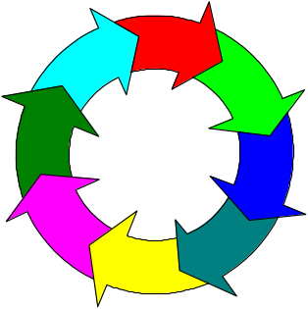
Icon design
Good icon design is difficult
Meaning of icons is cultural and context sensitive
Some tips:
  always draw on existing traditions or standards
  concrete objects or things are easier to represent than actions
From clip art, what do these mean
to you?

Slide 32
Screen design
Two aspects:
  How to split across screens
    moving around within and between screens
    how much interaction per screen?
    serial or workbench style?
  Individual screen design
    white space: balance between enough information/interaction and clarity
    grouping items together: separation with boxes? lines? colors?

Slide 33
Screen design: splitting functions across screens
Task analysis as a starting point
Each screen contains a single simple step?
Frustration if too many simple screens
Keep information available: multiple screens open at once

Slide 34
Screen design: individual screen design
Draw user attention to salient point, e.g. colour, motion, boxing
Animation is very powerful but can be distracting
Good organization helps: grouping, physical proximity
Trade off between sparse population and overcrowding

Slide 35
Information display
Relevant information available at all times
Different types of information imply different kinds of display
Consistency between paper display and screen data entry

Slide 36
Summary
Different kinds of prototyping are used for different purposes and at different stages
Prototypes answer questions, so prototype appropriately
Construction: the final product must be engineered appropriately
Conceptual design (the first step of design)
Physical design: e.g. menus, icons, screen design, information display
Prototypes and scenarios are used throughout design

